Slide 1
CUAE:
The Basics of the Platform and Technology
Seth Call

Slide 2
Session Objectives
At the end of this session, the participant should be able to:
Explain the architecture and purpose of the CUAE.
Explain why the CUAE is unique.
Understand at high level what the CUAE can do.
Conceptualize new potential applications.

Slide 3
What is the CUAE?
The Cisco Unified Application Environment is a complete platform for IPT applications hosted within Cisco CallManager deployments.
CUAE is an umbrella term for 3 discrete products:
  Cisco Unified Application Server
  Cisco Unified Media Engine
  Cisco Unified Application Designer

Slide 4
Technical Focus of the CUAE
The server-side components, CUAS and CUME, act as a protocol hub which custom-build applications can leverage.
  If the CUAS can receive or transmit the protocol traffic in question, then it’s a technically feasible protocol within the CUAE.
The Application Server supports a number of protocols:
  Call Control: SIP, H.323, SCCP, JTAPI 1st and 3rd party
  Cisco CCM: IP Phone Services, DeviceListX, AXL-SOAP, Extension Mobility…
  Data Interfaces: Web Services (client), SQL (client), LDAP (client), SMTP (client), HTTP (client and server)

Slide 5
Technical Focus of the CUAE (cont.)
The CUAD is an integrated development environment (IDE) that runs on a developer’s PC.
  Tightly integrated to the CUAS—single-click deployment of applications means minimal delay in development cycle, resulting in efficient developers.
  Drag-and-drop, graphical programming language for rapid and clear construction of application logic.
  Developer flexibility via the freedom to drop into .NET code within the CUAD to satisfy the most rigorous of application requirements.
  Modern features associated with modern IDEs, such as compile-time checking and runtime-debugging.

Slide 6
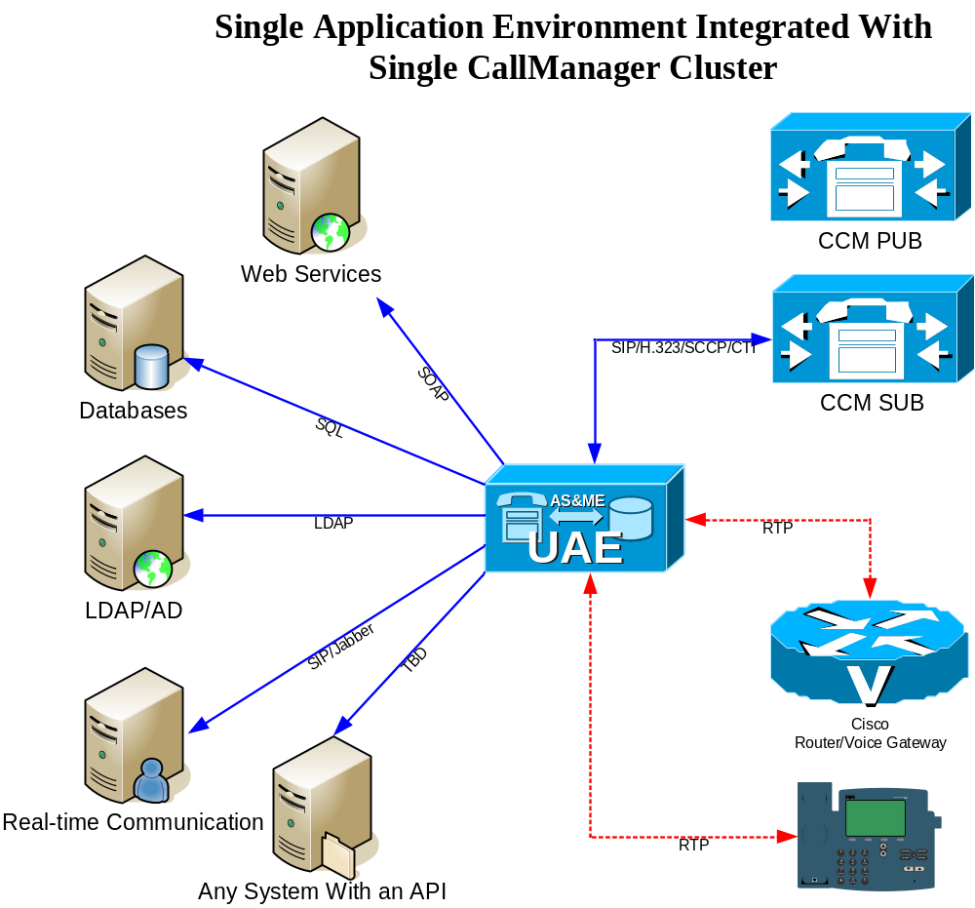
Deployment Architecture - Simple

Slide 7
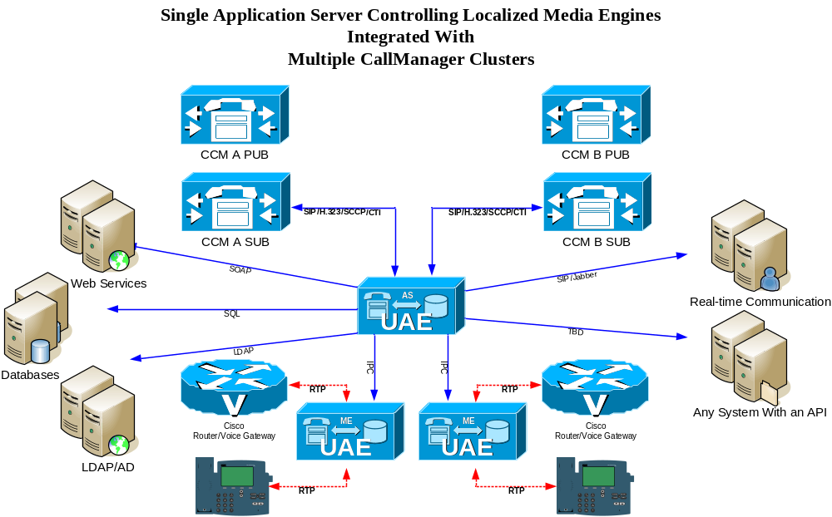
Deployment Architecture – Complex

Slide 8
How Does the Customer See the CUAE?
The CUAE allows one to
  HOST applications at an enterprise level (CUAS/CUME)
  DEVELOP such applications rapidly (CUAD)
What kind of customers do these features attract?
  Cisco CallManager deployments that want to go beyond dial tone.
  “I want to HOST applications that others have developed”
  Development shops that want to sell IPT applications.
  “I want to DEVELOP applications that others will host”
  Cisco CallManager deployments with a substantial IT department
  “I want to HOST and DEVELOP my own applications”

Slide 9
Why is the CUAE Different?
The CUAE is the most comprehensive IPT application platform, but why?
Enterprise-level, application platform and runtime.
Time of development and testing is minimized due to concise and powerful design patterns enforced by the CUAD.
Total control of calls and media audio streams.
Other IPT platforms exist, but none come close to feature set and level of unification with CallManager
Completely extensible.
  There isn’t native support for something?? Build it!

Slide 10
Why is the CUAE Different?
Applications can be built much more quickly (CUAD) and to a very high level of quality (CallManager APIs can change break applications--let the CUAS do the low-level heavy lifting and protect your app).
This results in more applications for customers and promotion of growth in the Cisco developer community!

Slide 11
Make Partners/Developers Successful
The barrier to development for CUAE/CCM should be as close to zero as possible.
In Summer 2007, an SDK download will become available for the CUAE, CCM, CUPS, and IP softphone. At this time CUAE will also support CUPS integration, adding a whole host of mobility and presence applications much more realizable.
  Our goal is to make these downloads as close to free as possible.

Slide 12
Understanding When the CUAE Is Needed
When the customer needs an application to streamline their business process.
But how does one know if the CUAE can help? To answer that question, you also need to be able to answer the following:
  What can CallManager telephony protocols do?
  What can the supported CallManager APIs do?
  What can the Media Engine do?
  What can the IP Phones do?
  Is there an API that will satisfy the data requirements of the application?

Slide 13
What can CallManager telephony protocols do?
CUAE performs 1st party call control using protocols which CCM has implemented in specific ways (SIP, H.323, SCCP, CTI). CUAE appears within CCM as a device—such as an SIP Trunk, H.323 Gateway, CTI Route Point, etc…
Any of these protocols allow an application to make and receive calls. Extended features, such as redirecting, transferring, shared-line, conferencing vary per protocol.
Bottom-line: A developer of the CUAE does not program to the protocol layer. A single application inherently supports each protocol!

Slide 14
What can the supported CallManager APIs do?
AXL-SOAP
  Dynamic changes of CallManager database. In general, if you can change it in ccmadmin, then you can change it using AXL.
JTAPI
  Real-time device information. If you need to know something is happening on a particular phone, or affect changes on the call as a 3rd-party…
Extension Mobility.
  Most common use of EM API is to create new interfaces for device profile login/logout outside of context of an IP Phone service.
Real-time device cache
  CUAE caches device info for all devices so that mapping of disparate device information becomes simple for developers (Device Name, IP address, line numbers, etc).

Slide 15
What Can the Media Engine Do?
Playing Text-to-speech, wav/vox files.
Recording streams to wav/vox files.
Speech Recognition (via Nuance)
Voice Fingerprinting (via PerSay)
Conferencing of multiple streams
Seamless transcoding of G.711, G.723, G.729, …
DTMF Collection

Slide 16
Is There an API?
A customer may ask for an application which needs to communicate with an outside system that the CUAE does not support out-of-the-box.
  There is only one question that must be asked “Is there an API that the CUAE can integrate into”?
  One can answer this question generically: If .NET code can be created which talks to the API, then an extension can be built for the CUAE.
  The only real complexity is gauging how difficult the integration effort would be. Generally one would leave that assessment to a CUAE application developer.

Slide 17
Licensing
There are 2 types of licensing associated with the CUAE: Node Licensing and Usage License
To unlock a CUAS node, you need a CUAS 2.3 Standard/Enhanced/Premium license.
To unlock a CUME node, you need a CUME 2.3 license.
Usage licensing comes in 3 forms:
  Script licensing
  Media Engine licensing
  Text-to-speech licensing

Slide 18
Script Licensing
Scripts are licensed by concurrency.
A CUAS node license comes with a base amount of script instance licenses already.
  Standard = 25
  Enhanced = 50
  Premium = 100
More script licenses can be purchased in the form of ‘packs’ to augment the base amount of script instances, but only up to the limit of instances imposed by the license type.
  Maximum for Standard = 50
  Maximum for Enhanced = 150
  Maximum for Premium = Unlimited

Slide 19
Script Licensing
2.3 has no enforcement of script licensing.
2.4 will enforce script licensing.
  A CUAS will be able to exceed its limit 10 times, and will alert the administrator. After the 10th time, the limit will be strictly enforced.

Slide 20
Media Engine Licensing
A Media Engine license is based on type of media resource used in conjunction with concurrency.
  RTP = each media stream uses 1 RTP resource at a minimum
  VOIce = play, record, DTMF use 1 voice resource
  CONference = each participant in conference uses 1 resource
  Speech INTegration = 1 per speech recognition operation
  Enhanced RTP = low-bite rate codec require 1 per stream
Media usage is always strictly enforced.
Note that one must have a UME2.3-H3.0-MR-NEW or UME2.3-H3.0-MR-ADD per Media License to act as a holder of resources.

Slide 21
Text-to-Speech Licensing
Text-to-speech licensing is based on the amount of concurrent files being generated, not the amount of concurrent text-to-speech operations on media streams.
It takes a very short amount of time to generate a TTS wav file—on the order of milliseconds for a short prompt.
TTS licensing is always strictly enforced.
Note that one must have a UME2.3-N3-TTS-NEW or UME2.3-N3-TTS-ADD per Media License to act as a holder of resources.

Slide 22
Support
Platform support is offered via UCSS (TAC).
  I’m HOSTing an Application Server and it’s not working right.
Developer support is offered via the Developer Services Program (AS-DS).
  I’m DEVELOPing an application and it’s not working right.

Slide 23
Sizing Metrics
One Application Server can support
  20k BHCA (aggregate inbound & outbound).
  20 HTTP requests / second.
One Media Engine can support 240 RTP streams.
  2.4 the maximum number of streams rises to 400.
  100% low-bite rate codec usage reduces capacity half.
  Maximum number of Media Engine streams is 120 if running co-located.

Slide 24
Sale Lifecycle
Determine the application(s) needed by the customer.
Target the partner to develop or supply the app.
Gather customer’s deployment requirements:
Build SKUs.

Slide 25
Determine Applications Needed
Some customers know applications they need.
If not, discussion of existing applications can help plant seeds.
TODO for CUAE group: Provide reference stories to expedite customer discussion.

Slide 26
Target Partner
As partner community grows, particular vertical spaces will have some number of partners to turn to.
Reduction of headcount or man-hours through business automation and productivity gains are done with applications usually tailored closely to the business process.
  Requires a partner who knows the space. does customer know exactly what they need.

Slide 27
Gather Customer Requirements
How many app instances will concurrently be operating?
What is the peak rate of calls/HTTP requests, or other ‘trigger’?
What are the redundancy requirements?
We will go through building SKUs later.

Slide 28

Application Design Walkthrough
Password Reset
Control of Lines via IP Phone Service

Slide 29
Password Reset
Password Reset is a horizontal, universally valid application. Automating password resets is of interesting to most companies.
Typical Requirements:
  I want my employees to be able to call a number and securely reset an account password.

Slide 30
Walkthrough the Application
Step 1: User dials into an application.
  1st party control via SIP, H.323, SCCP, or CTI.
Step 2: Application determines user ID.
  DTMF Collection / Speech Rec of unique Badge ID, followed by authentication step with voice fingerprint or other mechanism.
Step 3: Application asks for which system to reset.
  Text-to-speech to list systems, DTMF Collection / Speech Rec for determining which system user wants.
Step 4: Application resets that system password.
  Is There An API? (For Windows? For CCM?)
Step 5: Application says to user their new password.
  Text-to-speech the new password to user.

Slide 31
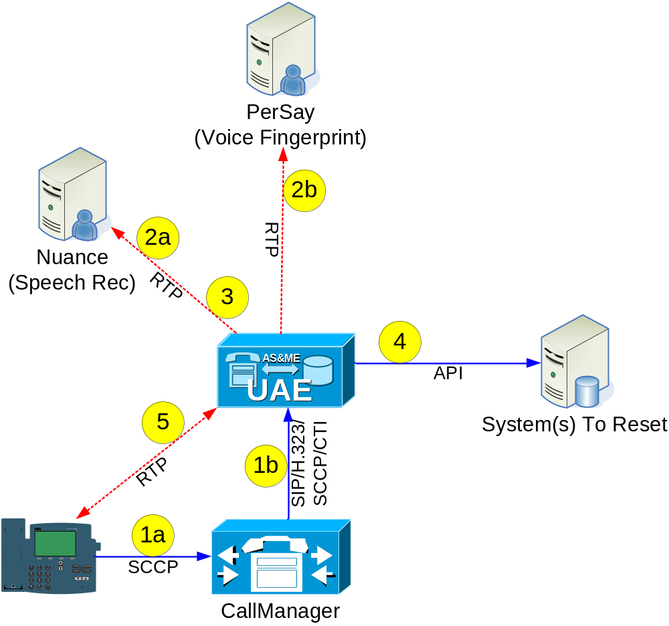
Walkthrough the Application

Slide 32
Exercise: From App Requirements to SKUs
Customer has 1000 users.
Customer expects average user to use Password Reset once every 6 months.
  2000 PR attempts per year / 12 / 30 = 6 resets per day.
  Assume that worst case concurrent resets is 5.
  Assume that worst case redundancy is far below 20k bhca.
Customer wants redundancy.
No low-bite rate codec support needed.

Slide 33
Exercise: From App Requirements to SKUs
Hardware & node licenses for co-located solution
  2 AP7845-K9-AS2.3-H1
  2 UAS2.3-S-25-50=
  2 UME2.3-H3.0=
Additional Script licenses
  Standard is sufficient due to 25 script licenses.
Media Engine licenses
  2 UME2.3-H3.0-MR-NEW
  10 UME2.3-H3.0-RTP-N
  10 UME2.3-H3.0-VOI-N
  10 UME2.3-H3.0-INT-N
Text-to-speech licenses
  2 UME2.3-N3-TTS-NEW
  2 UME2.3-N3-TTS-N
Notes:
1 7845-H1 per node. Can run CUAS & CUME co-located.

Slide 34
User Control CFA/CFtVM/RingSetting
A common feature request is to provide control of CFA, CF to VM, and the ring setting of each line.
Typical Requirements:
  I want to be able to use an IP Phone Service to control these settings for each line on my IP phone… or someone else’s IP phone.

Slide 35
Walkthrough The Application
Step 1: User initiates IP Phone Service to begin application.
  CUAE can act as a server for incoming HTTP requests.
Step 2: App needs to know which phone the user wants to control.
  AXL-SOAP allows CUAE to query and update a phone, given it’s device name. Configure IP Phone Service to pass in device name of the phone to be controlled as a query parameter.
Step 3: App lists each line that the user wants to control.
  AXL-SOAP getPhone/getLine operations will allow the application to determine all lines on the phone in question. Cisco IP Phone Menu support allows CUAE to build a menu of selectable items in response to phone.
Step 4: User selects a line to modify.
  AXL-SOAP updateLine operation will allow the application to modify CFA, CFtVM, and/or the RingSetting (along with other attributes of a line).

Slide 36
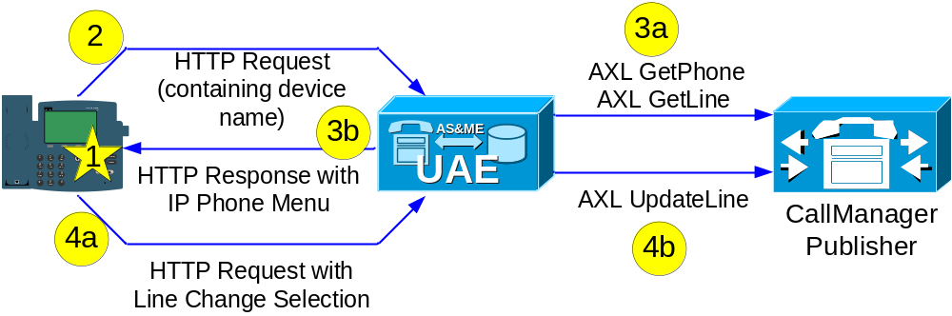
Walkthrough the Application

Slide 37
Exercise: From App Requirements to SKUs
Customer has 1000 users.
Customer expects average user to control-line once a day.
  1000 application uses per day.
  Worst-case hour is 500 uses.
  Worst-case minute is 10 uses.
Customer does not want redundancy

Slide 38
Exercise: From App Requirements to SKUs
Hardware & node licenses.
  1 AP7845-K9-AS2.3-H1
  1 UAS2.3-S-25-50=
  0 UME2.3-H3.0=
Additional Script licenses
  Standard is sufficient due to 25 script licenses.
Media Engine licenses
  0 UME2.3-H3.0-MR-NEW
Text-to-speech licenses
  0 UME2.3-N3-TTS-NEW
Notes:
1 7845-H1 per node. Can run CUAS & CUME co-located.

Slide 39
What Can the CUAE Not Do?
The CUAE can only do what the CallManager APIs make possible.
  For instance, it is generally not possible to change the native behavior of the IP phone. You can sometimes create what appear to be new features using JTAPI, but usually with a very complex and error-prone application.
Some CallManager APIs are not yet incorporated out-of-the-box, or only partially supported (although all of the below mentioned could be addressed through an extension):
  CDR (not addressed)
  AXL Serviceability API (not addressed)
  JTAPI (only partial API support)
  AXL-SOAP (only partial API support)
Speech Dictation
  Still reviewing 3rd-party technologies that could make this possible.

Slide 40
Session Objectives Summary
In this session, you:
Explained the architecture and purpose of the CUAE.
Explained why the CUAE is unique.
Understood at high level what the CUAE can do.
Conceptualized new potential applications.

Slide 41
Key Takeaways
The CUAE was architected from the ground up to support any CallManager deployment and to satisfy enterprise-level application requirements.
The CUAE is by far the most comprehensive platform for the development, debugging, testing, and execution of IPT applications.
Applications built on the CUAE can easily leverage a wide range of telephony, CallManager-specific, and data APIs, as well as be extended to support non-default APIs.
To understand potential new applications, it is very advantageous to have a high-level understanding of telephony, CallManager-specific, and data APIs that the CUAE can leverage.

Slide 42

Q and A

